Slide 1
Lesson 3:
Fundamentals of Twitter Bootstrap – Part 2

Slide 2








buttons
Bootstrap provides different styles of buttons:
To achieve the button styles above, Bootstrap has the following classes:
btn
btn-default
btn-primary
btn-success
btn-info
btn-warning
btn-danger
btn-link

Slide 3
Buttons
  Try it yourself

Slide 4
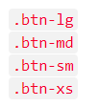

buttons
Button sizes

Slide 5

buttons
Block level buttons:
  A block level button spans the entire width of the parent element.
  Add class .btn-block to create a block level button:
Active / disable buttons:

Slide 6

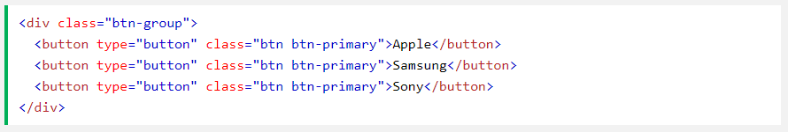
buttons
Button groups
  Bootstrap allows you to group a series of buttons together (on a single line) in a button group:
  Use a <div> element with class .btn-group to create a button group:

Slide 7
buttons
Reading
  Vertical button groups, justified button groups, Nesting button groups and dropdown button menus, split button dropdowns.

Slide 8
glyphyicons
Glyphyicons:
  Bootstrap provides 260 glyphicons from the Glyphicons Halflings set.
  Glyphicons can be used in text, buttons, toolbars, navigation, forms, etc.
  Syntax:

Slide 9
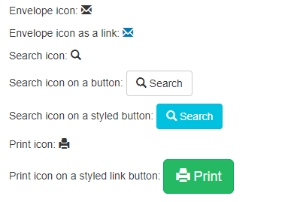
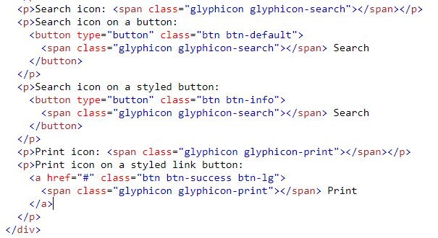
glyphyicons
Examples:

Slide 10

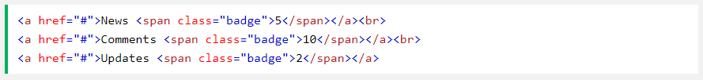
Badges and labels
Badges
  Are numerical indicators of how many items are associated with a link:
  The numbers (5, 10, and 2) are the badges.
  Use the .badge class within <span> elements to create badges:

Slide 11

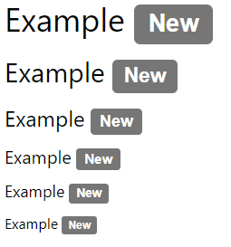
Badges and labels
They can be used inside other elements, such as buttons:
Labels
  Labels are used to provide additional
  information about something:

Slide 12
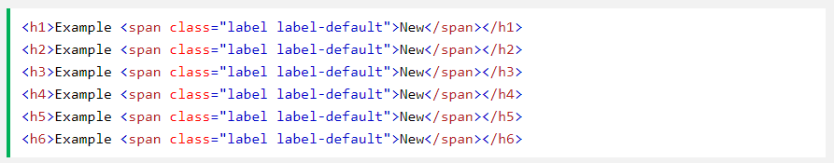
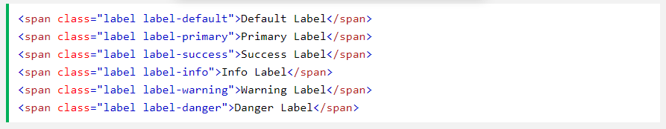
Badges and labels
They can be used inside other elements, such as buttons:
Contextual label classes

Slide 13

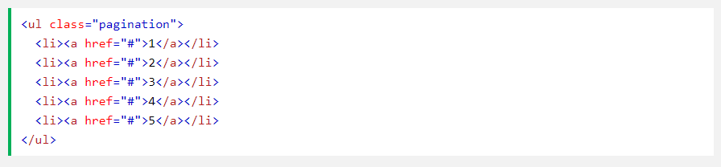
pagination
Pagination
If you have a web site with lots of pages, you may wish to add some sort of pagination to each page.
A basic pagination in Bootstrap looks like this:
To create a basic pagination, add the .pagination class to an <ul> element:

Slide 14
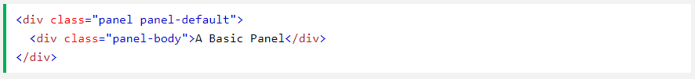
PANELS
Panels
  A panel in bootstrap is a bordered box with some padding around its content:
  Basic panel:

Slide 15
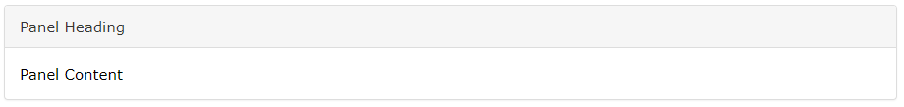
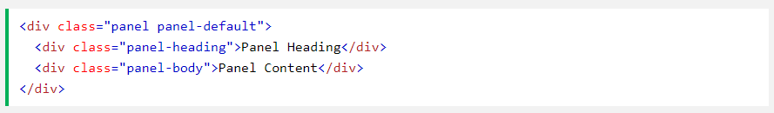
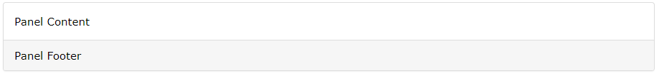
pagination
Panel Heading:
Panel Footer: The .panel-footer class adds a footer to the panel:

Slide 16
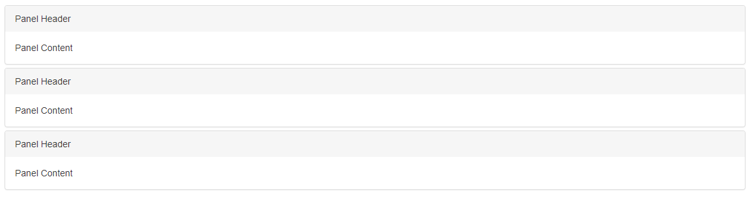
pagination
Panel Group

Slide 17
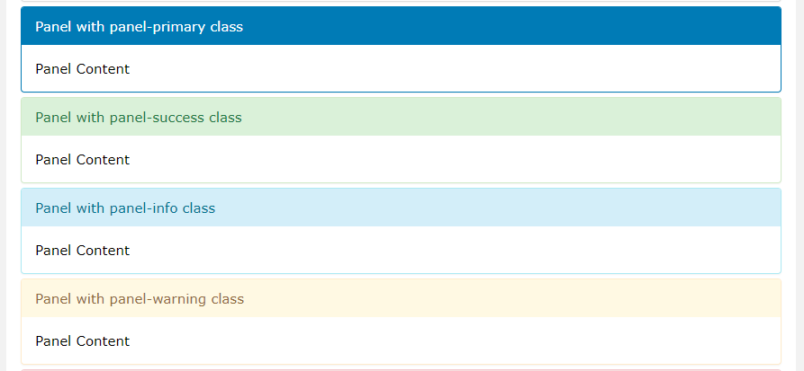
pagination
Panels with Contextual Classes

Slide 18
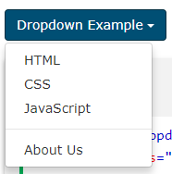
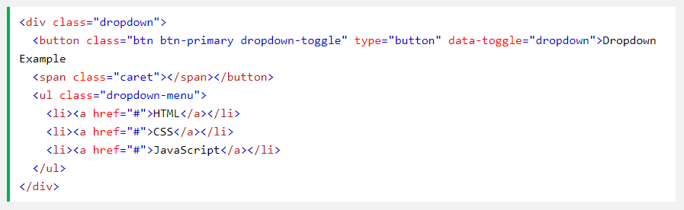
dropdowns
Basic Dropdown
  A dropdown menu is a toggleable menu that allows the user to choose one value from a predefined list:

Slide 19
dropdowns
Example Explained
  The .dropdown class indicates a dropdown menu.
  To open the dropdown menu, use a button or a link with a class of .dropdown-toggle and the data-toggle="dropdown" attribute.
  The .caret class creates a caret arrow icon (), which indicates that the button is a dropdown.
  Add the .dropdown-menu class to a <ul> element to actually build the dropdown menu
.

Slide 20
dropdowns
Reading:
  Dropdown position, dropup, dropdown divider, dropdown header, disable and active items, dropdown accessibility.
.

Slide 21
dropdowns
  EXERCISES

Slide 22
Thank You!

